Slide 1
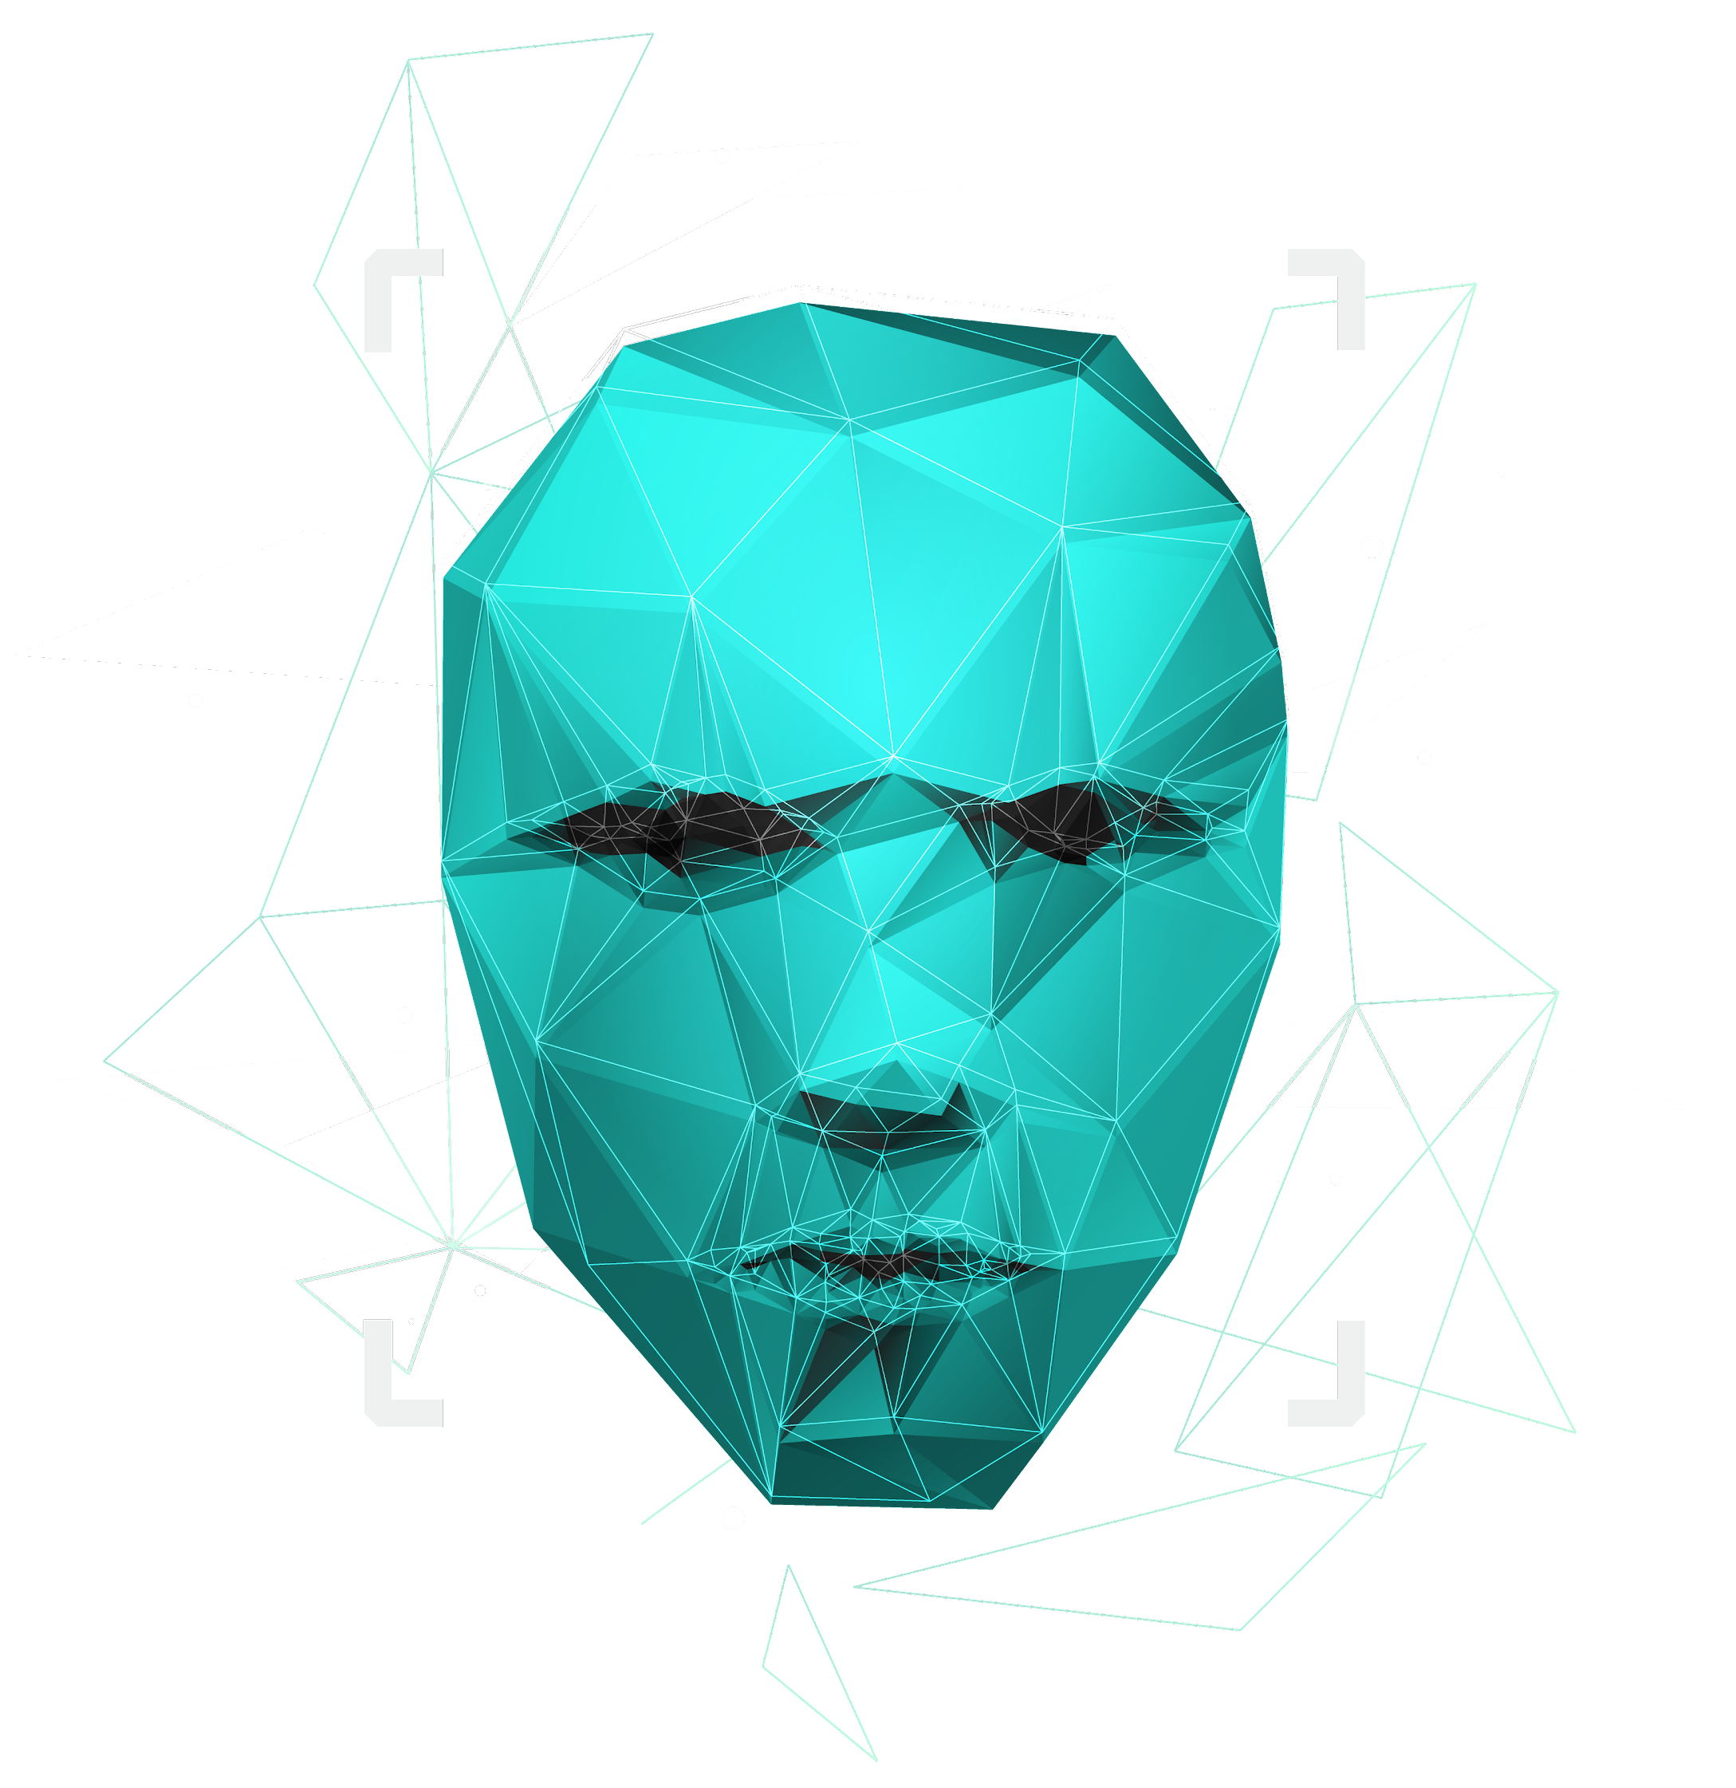
Analyzing Employee Absenteeism
USING
ML

Slide 2


Objective:
Q1
Analyze Employee Absenteeism
Extract Actionable Insights
Q2
Q3
Impact of Factors
Predict Future Absenteeism
Q4
Q5
Forecast Absence Duration
Improve Decision Making
Q6

Slide 3
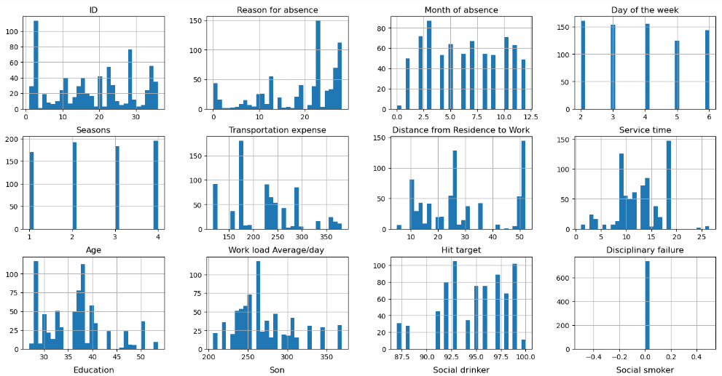
feature distribution

Slide 4
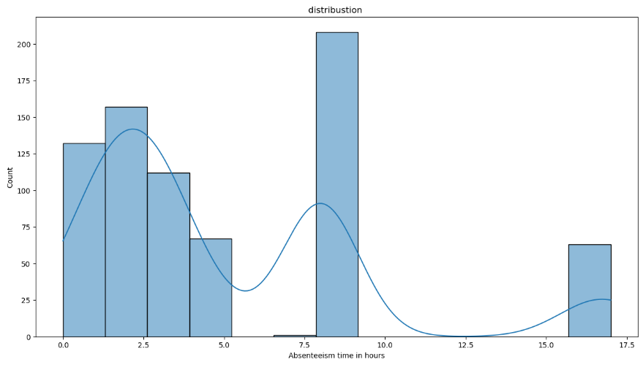
Interpretation:
The right-skew indicates that there are some cases of extended absences, which might be worth investigating to identify potential causes and address them. The majority of absences fall within the 2-10 hour range, which could be considered typical.

Slide 5
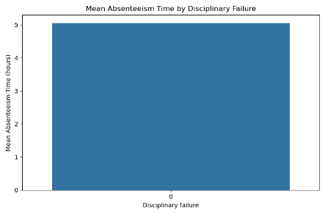
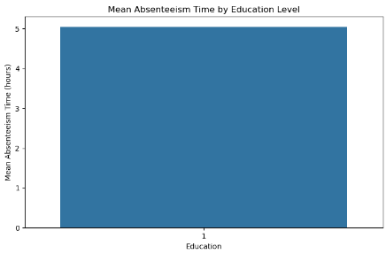
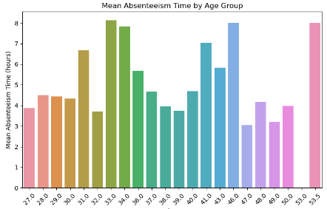
Interpretation:
There appears to be a general trend of higher absenteeism rates among younger age groups. Younger employees (27-30): While there's some variation, this group generally has higher absenteeism rates compared to older age groups. Middle-aged employees (31-45): This age range consistently shows lower absenteeism rates. This could be attributed to factors like greater work experience, stability in personal life, or peak physical health. Older employees (46+): Absenteeism rates vary significantly within this group. Some age groups (e.g., 46-47) have higher absenteeism, while others (e.g., 51-52) have lower rates. This might be influenced by health conditions, retirement planning, or other personal factors.

Slide 6
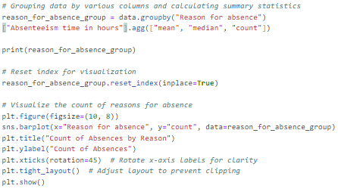
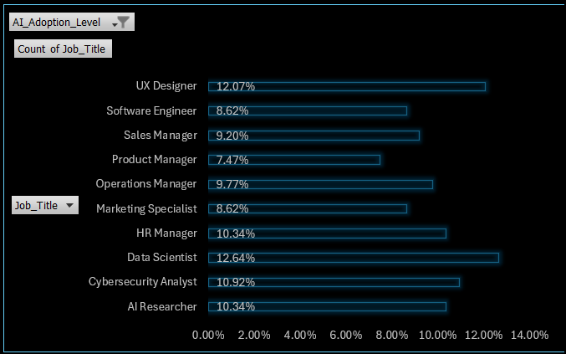
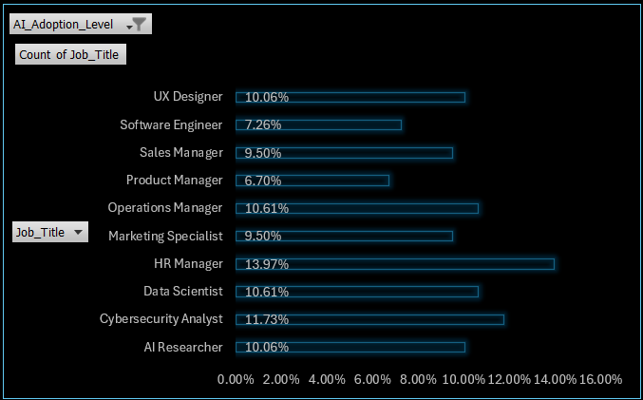
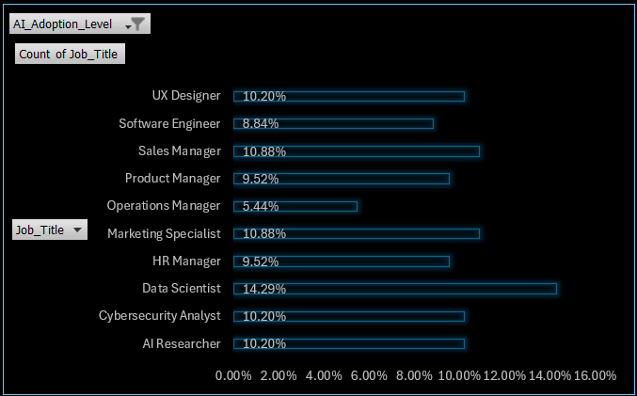
Interpretation:
Least count of Absence: Reasons 2-5: These likely refer to broad categories of diseases, such as cancer, blood disorders, metabolic diseases, and mental health conditions. Reasons 24 and 25: These might indicate medical procedures like blood donation and laboratory tests. Reasons 16 and 17: These could represent health issues related to pregnancy and childbirth, such as complications during or after birth, or congenital abnormalities.
High
Medium
Low
Data scientist job roles has highly adopted AI among all other significantly by 14.29%.

Slide 7
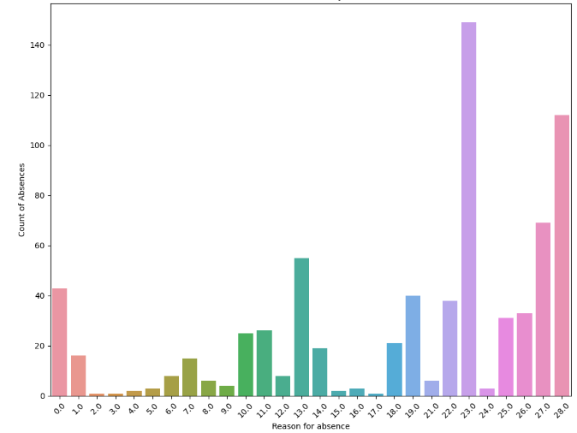
Interpretation:
Overall, the bar plot provides valuable insights into the reasons for absenteeism within the organization. The dominance of reasons 23.0 and 28.0 suggests that these are the primary factors contributing to absenteeism in the organization. These reasons might correspond to specific categories like "unjustified absence," "medical consultation," and "dental consultation."A number of other reasons, such as 19, and 21, have relatively low counts. These might represent less frequent occurrences like "injury" or "external causes."
Q4

Slide 8
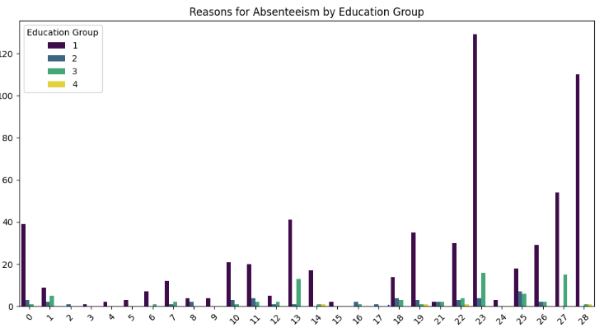
Interpretation:
Most Common Reasons: Among the high school education group, the most common reasons for absenteeism are 23, 27, and 28, which likely correspond to medical consultations, physiotherapy, and dental consultations. This suggests that a significant portion of absences in this group are due to health-related issues requiring medical attention. Fewer Instances of Serious Illnesses: Reasons II (Neoplasms), III (Blood disorders), IV (Endocrine diseases), and V (Mental health disorders) have fewer instances, indicating that these serious health conditions are less prevalent among this group.

Slide 9
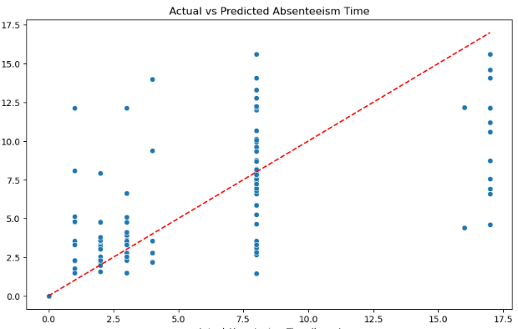
Interpretation:
MSE: The mean squared error has decreased from 21.1768 to 12.7922. This means the average squared difference between predicted and actual values has reduced, indicating better overall accuracy.
MAE: The mean absolute error has decreased from 3.3269 to 2.2944. This shows a reduction in the average absolute difference between predictions and actual values, indicating more consistent accuracy.
RMSE: The root mean squared error has decreased from 4.6018 to 3.5766. This represents a reduction in the average magnitude of the errors, suggesting that the model is making more accurate predictions overall.
R²: The R-squared value has increased from 0.0333 to 0.4160. This indicates that the final model explains a much larger portion of the variability in the target variable, suggesting a stronger relationship between the independent variables and the dependent variable.
The improvements in all metrics demonstrate that the final model is a better fit for the data and provides more accurate predictions.

Slide 10
Interpretation:
Accuracy: 0.6689
ROC AUC: 0.7180
Classification Report:
{'0': {'precision': 0.7012987012987013, 'recall': 0.675, 'f1-score': 0.6878980891719745, 'support': 80.0}, '1': {'precision': 0.6338028169014085, 'recall': 0.6617647058823529, 'f1-score': 0.6474820143884893, 'support': 68.0}, 'accuracy': 0.668918918918919, 'macro avg': {'precision': 0.6675507591000549, 'recall': 0.6683823529411765, 'f1-score': 0.6676900517802319, 'support': 148.0}, 'weighted avg': {'precision': 0.6702870787377829, 'recall': 0.668918918918919, 'f1-score': 0.6693285412984812, 'support': 148.0}} Accuracy: Both models achieved similar accuracy scores:
Logistic Regression: 0.6622
KNN: 0.6689
Classification Report: The classification reports provide a detailed breakdown of the models' performance on each class (high absenteeism vs. low absenteeism). Both reports indicate:
Precision: The models are slightly better at identifying employees without high absenteeism (class 0) than those with high absenteeism.
Recall: Both models struggle slightly more with recalling employees who actually have high absenteeism (class 1).
F1-Score: This metric combines precision and recall, and both models have similar F1 scores for each class.
ROC-AUC Score: Logistic Regression: 0.7549 KNN: 0.7180
from sklearn.model_selection import train_test_splitfrom sklearn.preprocessing import StandardScalerfrom sklearn.linear_model import LogisticRegressionfrom sklearn.neighbors import KNeighborsClassifierfrom sklearn.metrics import classification_report, accuracy_score, roc_auc_score# Separate features and target variableX = df_cleaned.drop('High Absenteeism', axis=1)y = df_cleaned['High Absenteeism']# Split the data into training and testing sets (80% train, 20% test)X_train, X_test, y_train, y_test = train_test_split(X, y, test_size=0.2, random_state=42, stratify=y)# Scale the features (important for KNN)scaler = StandardScaler()X_train_scaled = scaler.fit_transform(X_train)X_test_scaled = scaler.transform(X_test)# Initialize modelslogreg = LogisticRegression(random_state=42)knn = KNeighborsClassifier(n_neighbors=5)# Train Logistic Regression modellogreg.fit(X_train_scaled, y_train)# Train KNN modelknn.fit(X_train_scaled, y_train)# Make predictionsy_pred_logreg = logreg.predict(X_test_scaled)y_pred_knn = knn.predict(X_test_scaled)# Evaluate both modelslogreg_accuracy = accuracy_score(y_test, y_pred_logreg)knn_accuracy = accuracy_score(y_test, y_pred_knn)logreg_report = classification_report(y_test, y_pred_logreg)knn_report = classification_report(y_test, y_pred_knn)logreg_roc_auc = roc_auc_score(y_test, logreg.predict_proba(X_test_scaled)[:, 1])knn_roc_auc = roc_auc_score(y_test, knn.predict_proba(X_test_scaled)[:, 1])logreg_accuracy, knn_accuracy, logreg_report, knn_report, logreg_roc_auc, knn_roc_aucfor model, metrics in results.items(): print(f"{model}:\n") print(f"Accuracy: {metrics['Accuracy']:.4f}") print(f"ROC AUC: {metrics['ROC AUC']:.4f}") print("Classification Report:") print(metrics['Classification Report'])

Slide 11
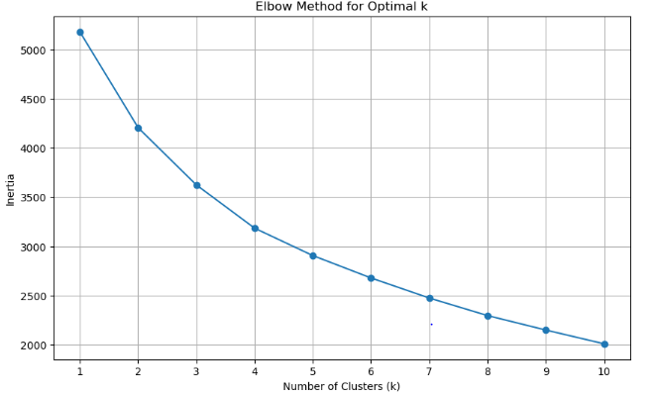
Interpretation:
Elbow Method Plot: The plot shows the inertia values for different numbers of clusters (k). As k increases, inertia decreases, indicating better clustering. The "elbow" point appears around k = 4 or 5, suggesting these values are optimal for clustering, as beyond this point, the reduction in inertia becomes less significant.
Absenteeism by Education Group: The analysis groups absenteeism data by education and reason for absence. The resulting bar plot will visually illustrate how different education levels impact the frequency of various absence reasons. This insight can help organizations develop targeted strategies to address absenteeism based on educational backgrounds, ultimately enhancing workforce management.

Slide 12
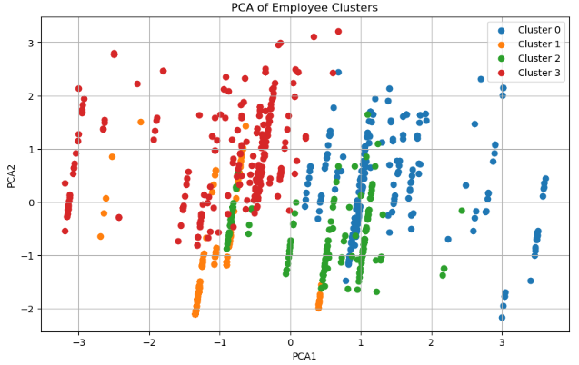
Interpretation:
Cluster Separation: The clusters are well-separated, showing distinct employee groups.
Cluster Insights: Clusters that are closer may share similar traits, while distant clusters have more differences.
Dimensionality: This 2D view simplifies complex relationships, helping to better understand the clustering.
it helps in identifying unique characteristics of each employee group for better workforce management.

Slide 13
Conclusion

Slide 14
Through a comprehensive analysis using clustering, dimensionality reduction (PCA), and predictive modeling, key insights emerged:
Employee Clustering: The PCA visualization revealed distinct clusters of employees, indicating different groupings based on their work-related features. This helps in tailoring management strategies, identifying specific needs, and enhancing workforce management.
Absenteeism Insights: Patterns in absenteeism reasons were identified, with medical consultations being the most frequent across several education and age groups. This suggests that health-related absences play a significant role in overall absenteeism.
Model Accuracy: The logistic regression and KNN models were compared for predicting absenteeism. Both models achieved similar accuracy (~66%), with logistic regression slightly outperforming KNN in differentiating between high and low absenteeism using the ROC-AUC metric.
Improvement in Metrics: Model performance metrics improved after optimization. The decrease in MSE, MAE, and RMSE, along with the rise in R², indicated better predictions in models focusing on absenteeism and employee behavior.

Slide 15
The project provided valuable insights into employee behavior, absenteeism patterns, and how data-driven approaches can improve workforce management and operational strategies. The findings offer actionable recommendations for reducing absenteeism and enhancing productivity.
Conclusion
ML

